Slide 1

Pocket Library™
one broke student at a time

Slide 2
Contents
Background & Objective
Scope
Use Cases
Class Diagram
Design Principles and Patterns
Sequence Diagram
Prototype
Conclusion

Slide 3
Group Members
Rishabh Tandon - 54106672 - Project Manager
Olivia Woodhouse - 40115805 - Analyst
FENG Fanjuan - 54779590 - Designer
Rohan Sabharwal- 54592018 - Programmer
DING Linli - 54382328 - Tester
ZHANG Xilin - 54780379 - Maintainer

Slide 4
Background & Objectives
Statistics
$1.2 trillion in student loan debt in United States
With nearly 44 million borrowers, each student averages an outstanding loan balance of about $37,172
The cost of university textbooks rose by %82 between 2002 and 2013
%65 of students stated they had decided against buying a textbook due to its price tag
Objectives
Pocket Library™: a subscription-based platform for students to gain access to e-books, community, guidance, as well as a venue for buying/selling copies of used books
We hope to alleviate some of the heavy costs that textbooks require and to mitigate some of the stress of being a student by providing a platform for students to interact and access guidance from our verified tutors
Better for the environment
Making education more accessible!
Weisbaum, Herb. “College Textbook Costs More Outrageous than Ever.” CNBC, CNBC, 28 Jan. 2014, www.cnbc.com/2014/01/28/college-textbook-costs-more-outrageous-than-ever.html.
Dickler, Jessica. “Student Loan Interest Rates Edge Higher and Higher.” CNBC, CNBC, 18 July 2017, www.cnbc.com/2017/07/18/student-loan-interest-rates-edge-higher-and-higher.html.
Notes:
With about 1.2 trillion dollars in student loan debt affecting nearly 44 million borrowers, each of whom averaged an outstanding loan balance of $37,172 in the United States alone, it is safe to say that student debt is a global epidemic. To make matters worse, university textbooks don’t help to ameliorate this problem in the slightest. Textbook prices have risen to an outrageous inflation in recent years. A study done approximated that the price of university textbooks rose by 82 percent between 2002 and 2013. This makes getting an education highly inaccessible for students who simply cannot afford these steep figures.
For this reason we have created Pocket Library™, a subscription-based platform for students to gain access to e-books, community, guidance, as well as a venue for buying/selling copies of used books. It is basically a one stop shop for students to manage all of their textbook needs. Not only does it help to alleviate some of the heavy costs that textbooks may require, but it also helps to mitigate some of the stress of being a student by allowing students to not only interact and help one another on our many discussion platforms but also to have access to guidance and answers from our verified tutors.
Our goal as a team of students is to make life a little easier for our peers and well as ourselves who are also struggling through the day-to-day obstacles of being university students. Based on a survey of more than 2,000 students from over 150 different campuses, 65 percent declared that they had decided against buying a textbook due to its price tag. We are here to make sure no student goes without an adequate education due to the lack of resources that are accessible to them. It is time to make education accessible and sustainable with Pocket Library™!

Slide 5
Scope
Determining a list of project goals, deliverables, and tasks for Pocket Library™

Slide 6
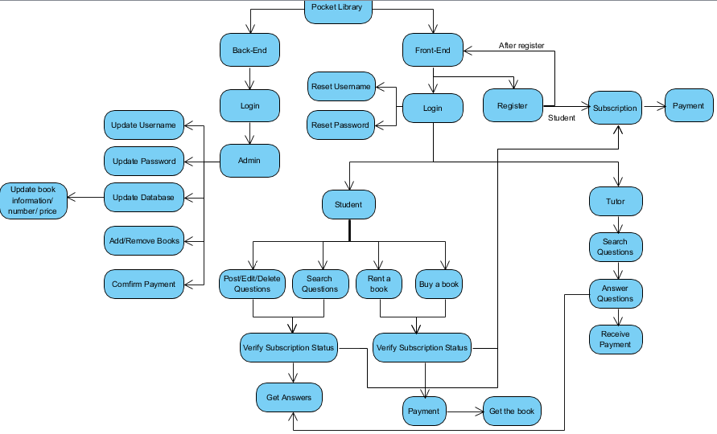
Notes:
So I am going to talk about the scope of our Design. Firstly, we divide the Pocket Library System into two parts, the left side is the back-end and the right side is the front-end of the software. Considering the front-end side, people register for their own account and for students they can choose their subscription status, like only need online question-answering service or need both question-answering and the renting/ Purchase service . Then they would pay for the subscription and return to the login page.
In the login page there are some general things such as reset username and reset password. After log in, for students, they can do a few things in the software. They can post/edit/delete their own questions and also search for questions which has been answered before. However students can get the answers only when the system verifies that they have subscribed for the question-answering service.
And the students could also rent books and purchase books on this platform. The books are second-hand and much cheaper. Only students who subscribe the book-renting/buying service can have the right to rent and purchase cheap books.
For the tutors, they can search for questions to answer and after students get the answers they would get paid.
And considering the back-end side,which would be served for the administratives, the administratives would use the software to manager user information and book information, also confirming payment, which comes from student subscription for question-answering and book-lending/purchasing.

Slide 7
Functional Requirements
Registration Module
Login Module
Exploration Module
Lending/Purchasing Module
Admin Module

Slide 8

Process Model
Prototype Model
Our product is heavily reliant on our customers because without widespread customer support and feedback, our product becomes invaluable
This is why we chose the Prototype Evolutionary Process Model as this allowed us to communicate, strategize, and survey our target market throughout the process of development
We developed a mock prototype to show the user and built our entire project around prototype refinements based on the responses we receive from both our internal development team and a few external users used for testing purposes.

Slide 9
Use Cases
For a behavioral analysis of the actions of the entire Pocket Library™ system

Slide 10
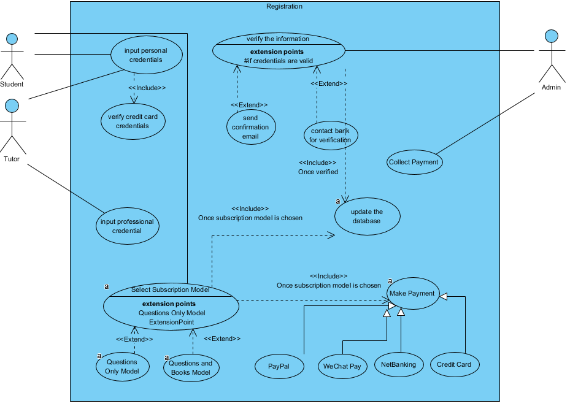
Registration Module

Slide 11
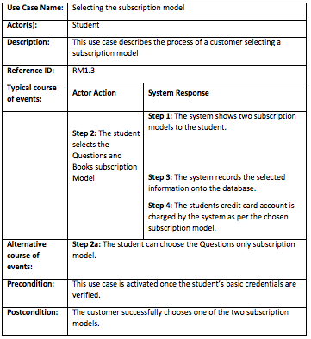
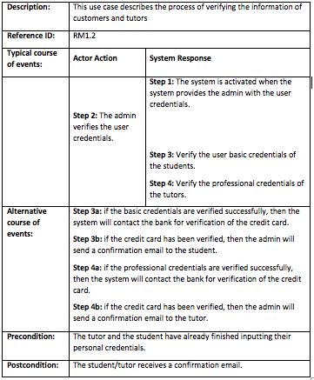

Slide 12
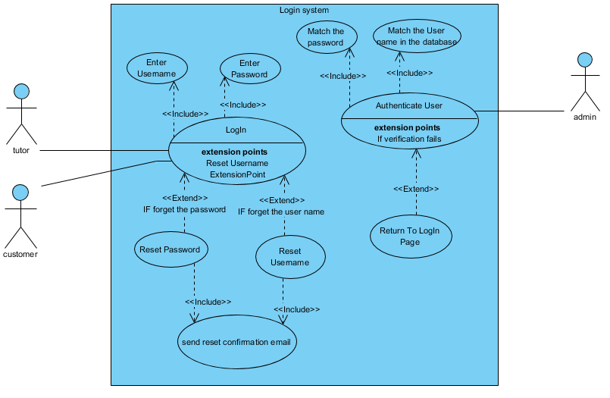
Place your screenshot here
Log In
Module

Slide 13
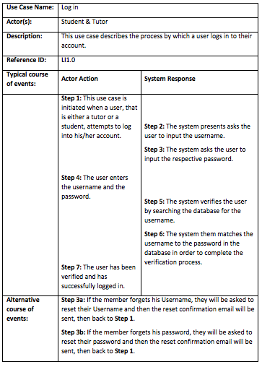


Slide 14
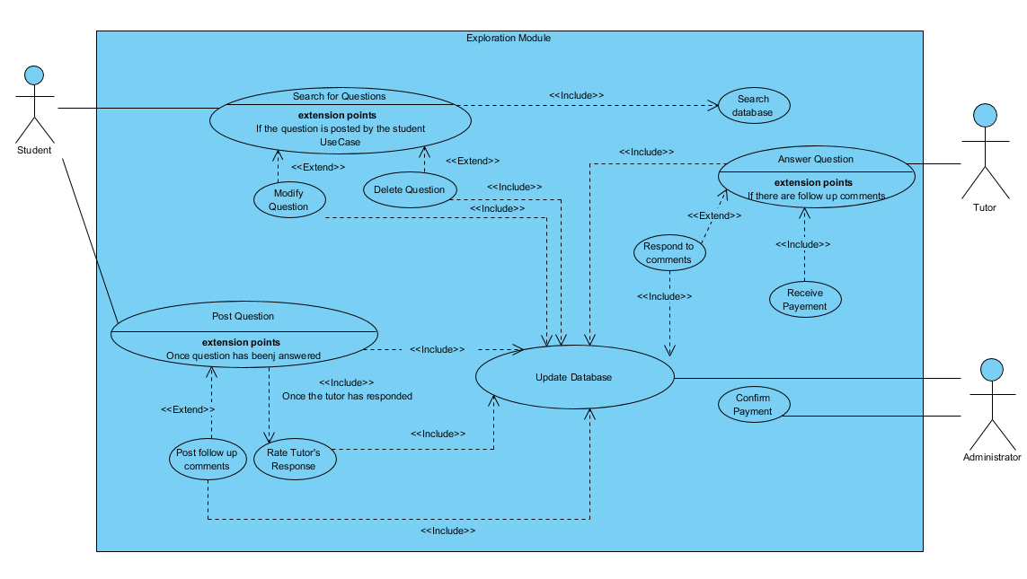
Exploration Module

Slide 15
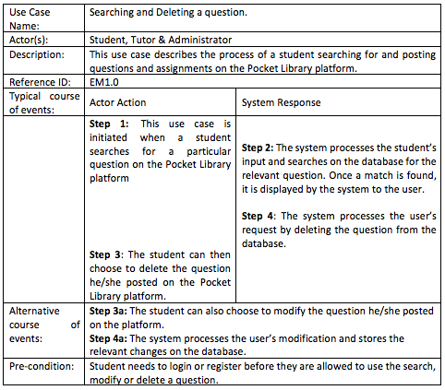
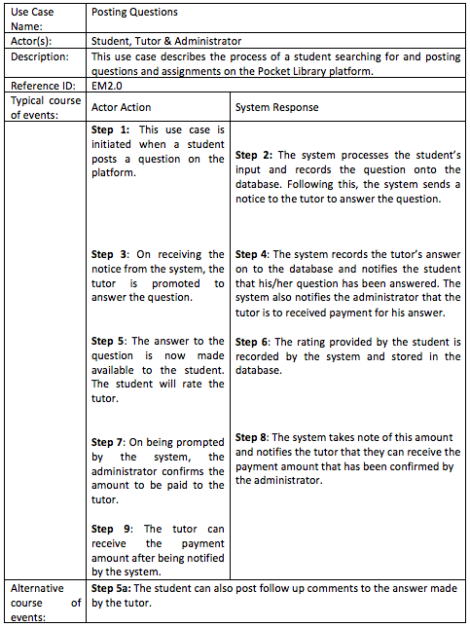

Slide 16
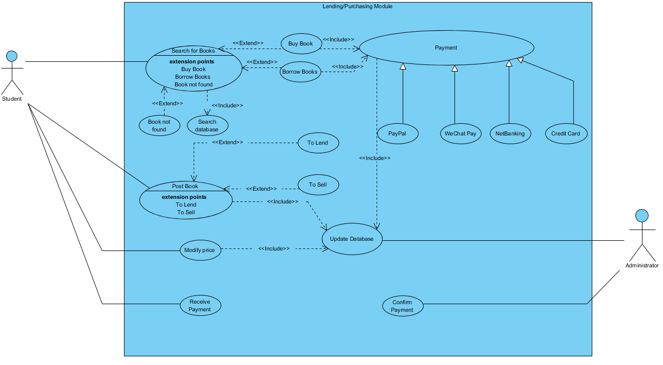
Lending/
Purchasing Module

Slide 17
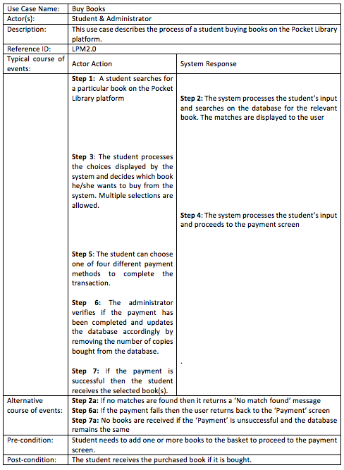
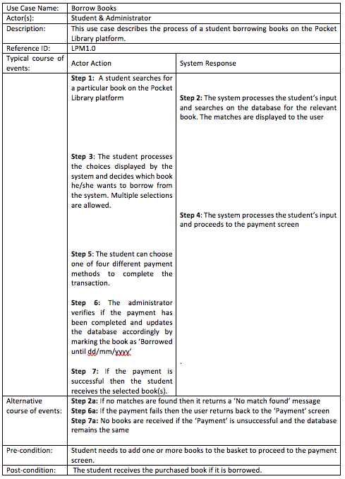

Slide 18
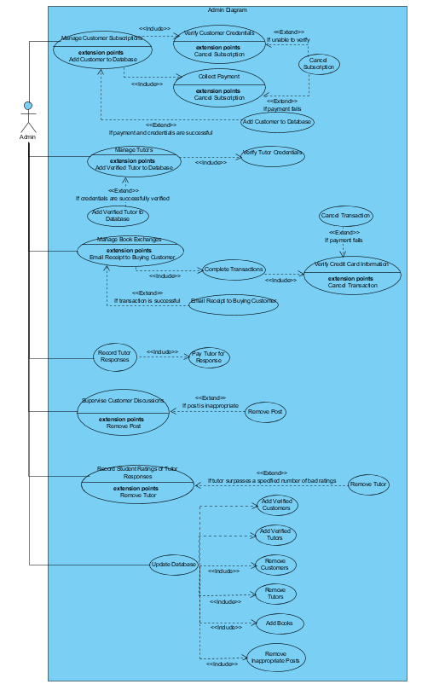
Admin Module

Slide 19
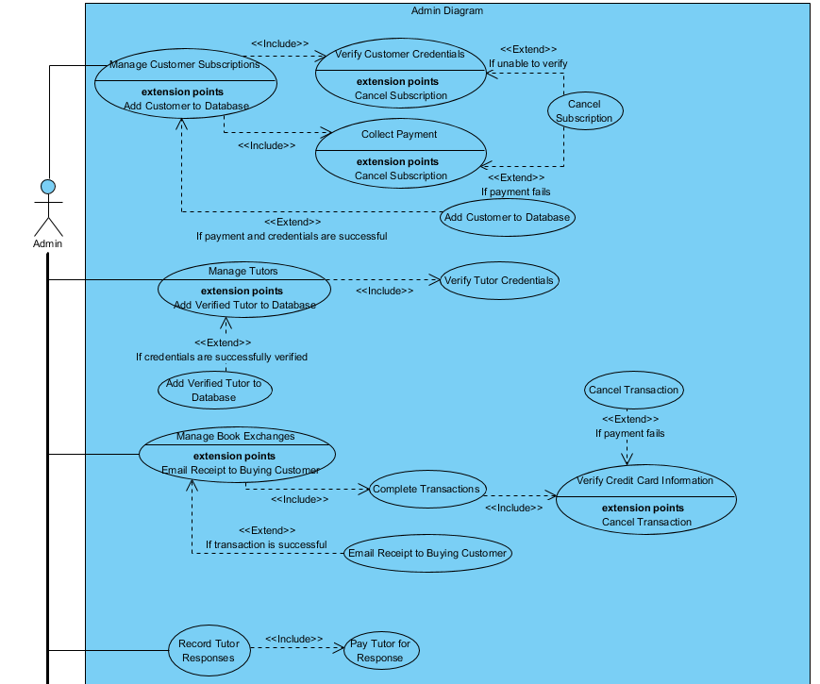
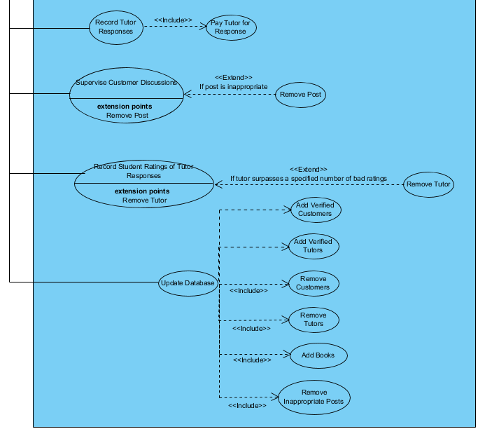

Slide 20
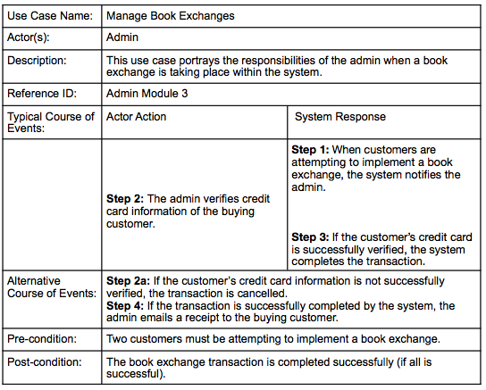
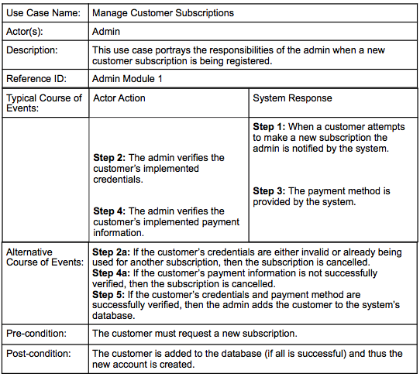

Slide 21
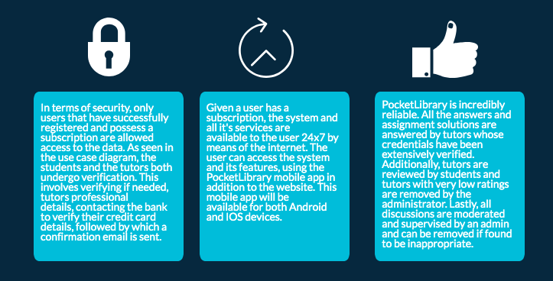
Non -Functional Requirements

Slide 22
Class Diagrams
For an efficient and easy-to-maintain Pocket Library™

Slide 23
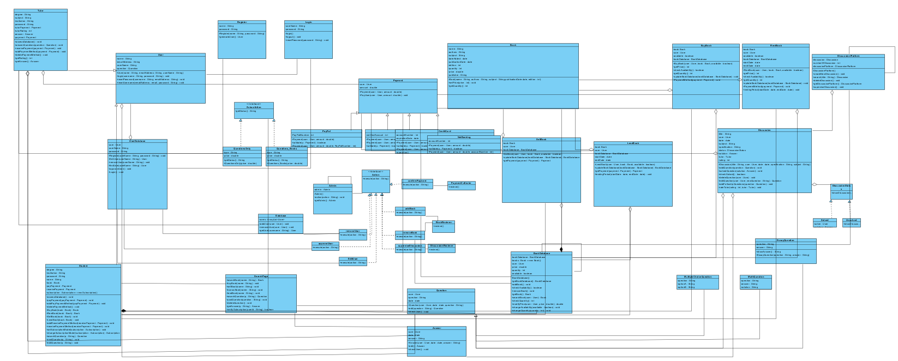

Slide 24
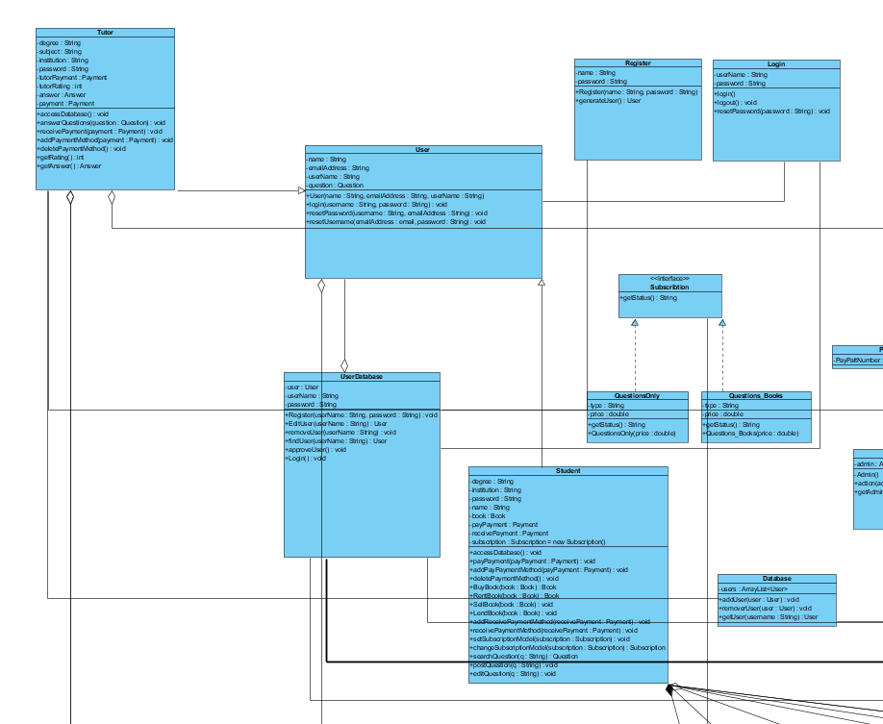

Slide 25
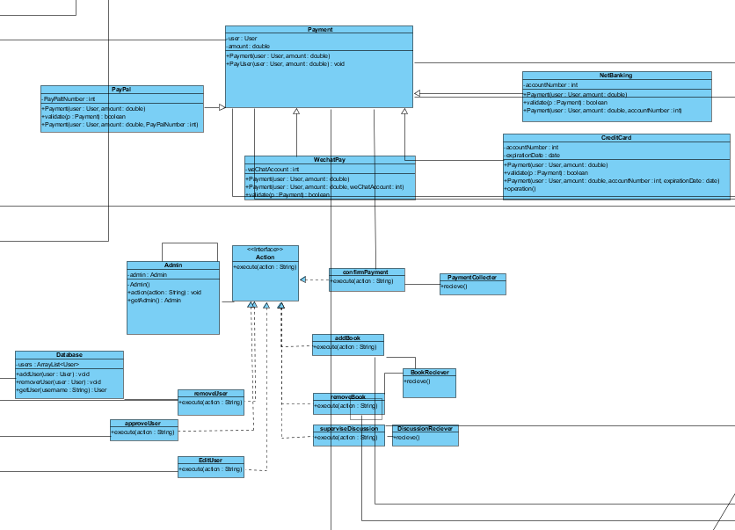

Slide 26
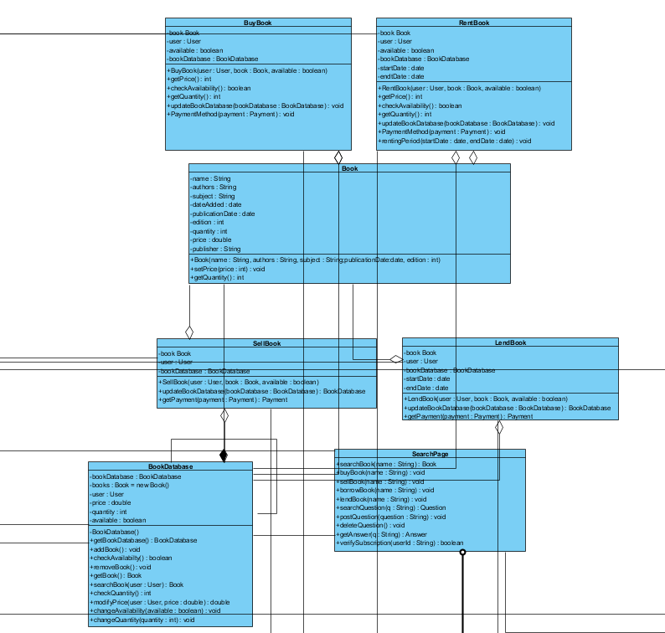

Slide 27
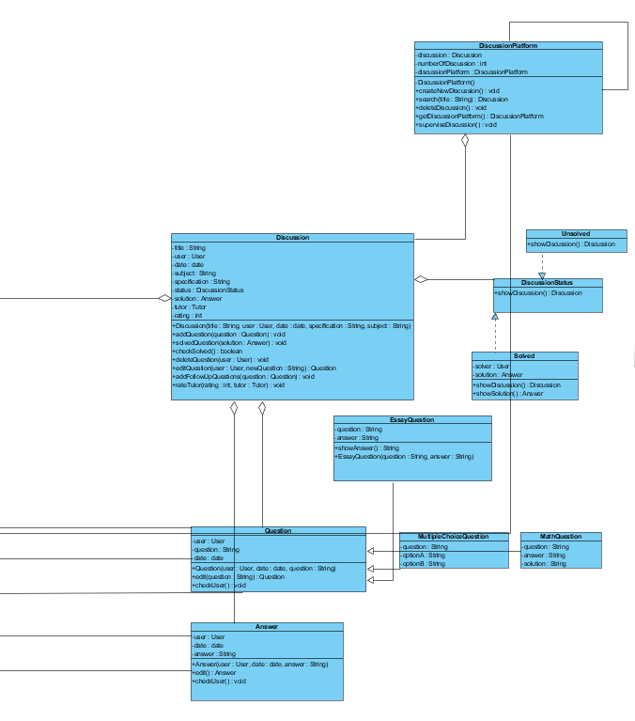

Slide 28
Design Principles and Patterns
For an efficient-working Pocket Library™ system using industry standard practice

Slide 29
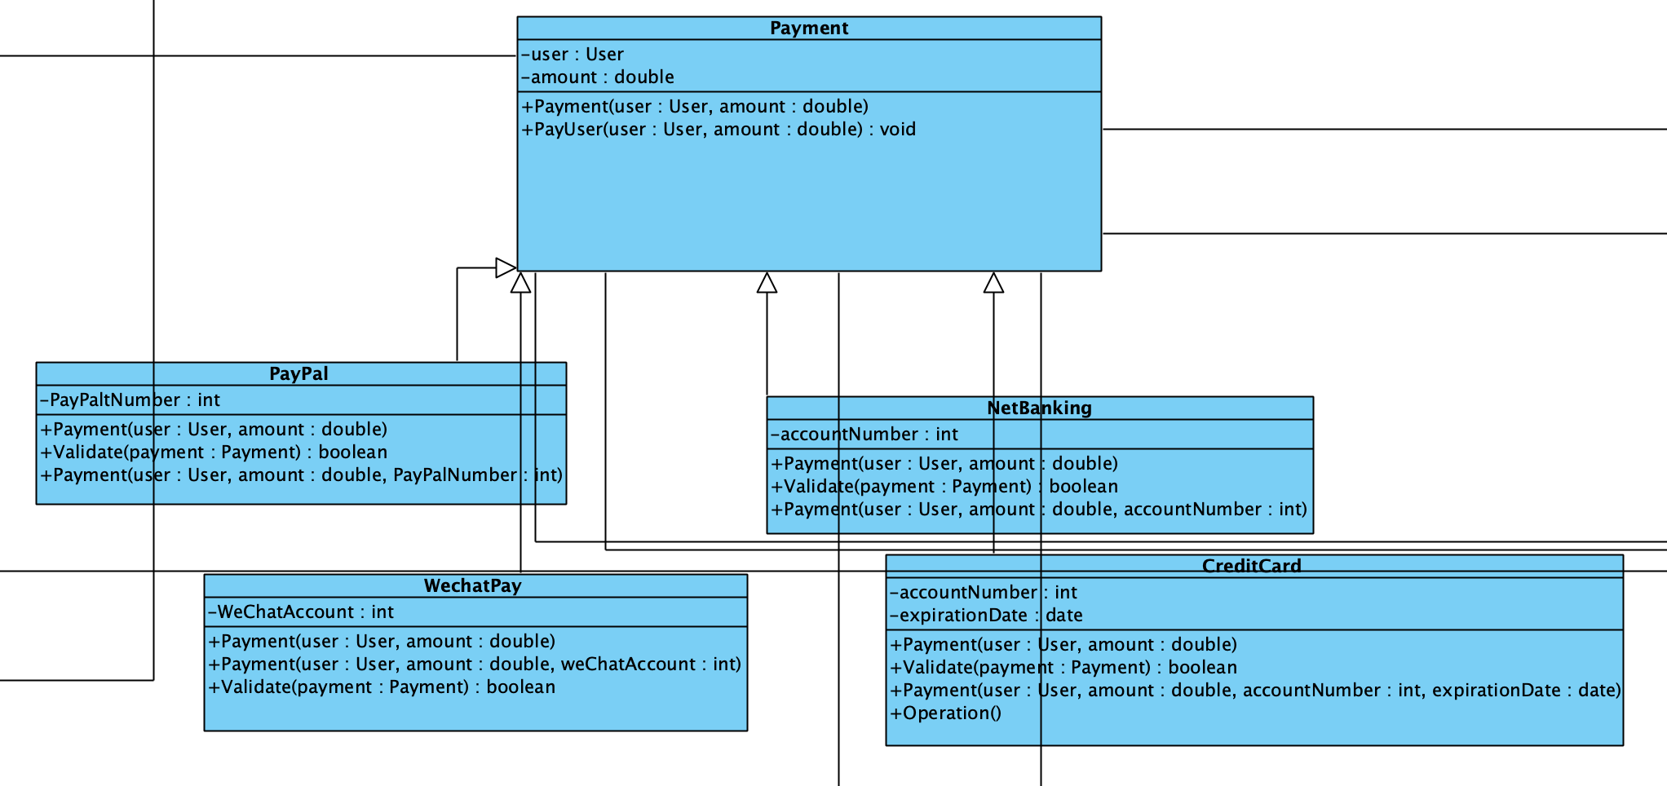
Liskov Substitution Principle
(LSP)

Slide 30
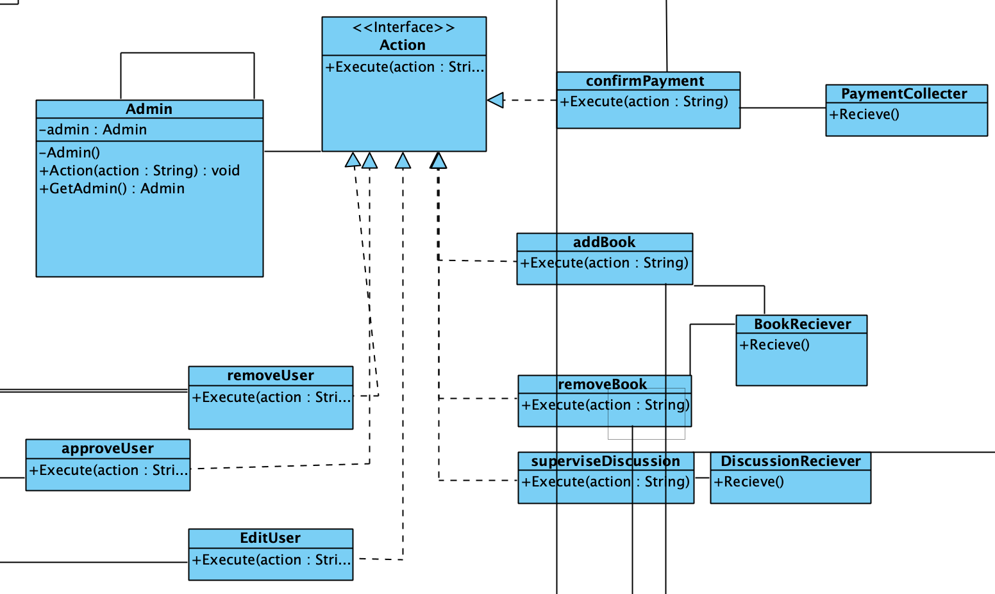
Command pattern

Slide 31
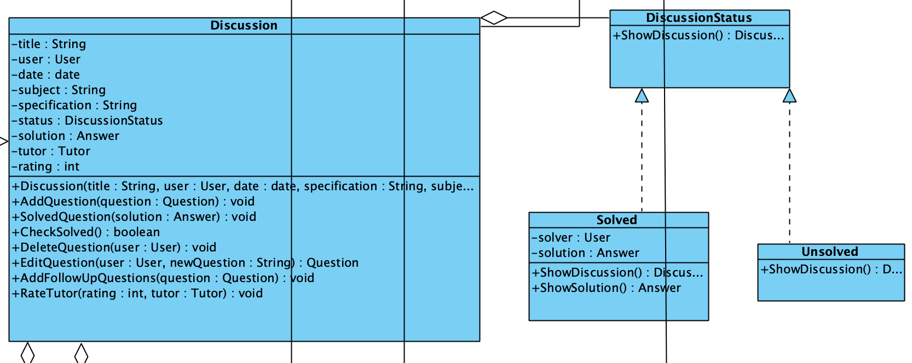
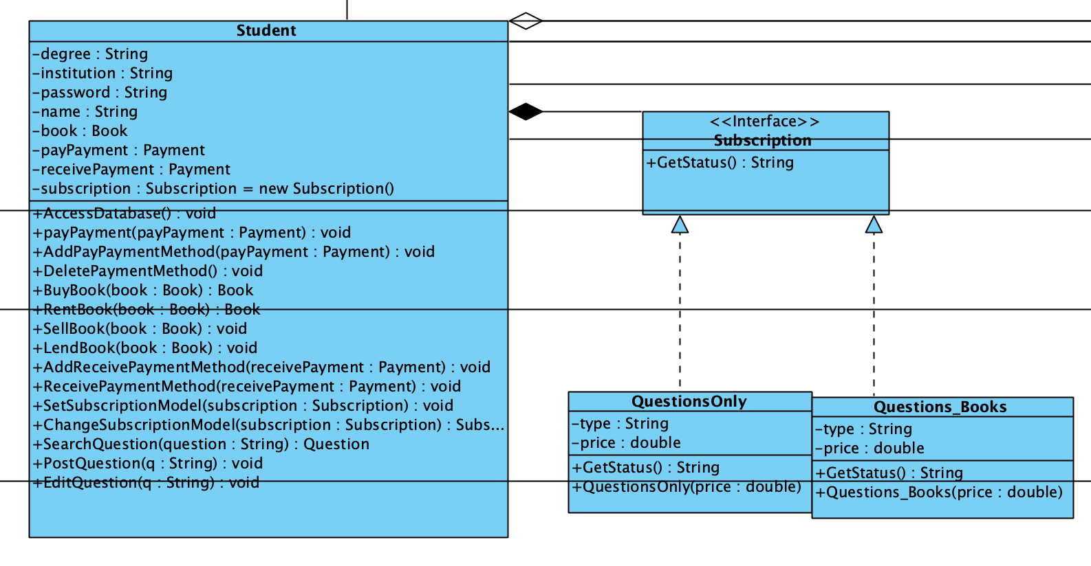
State Pattern

Slide 32
Sequence Diagrams
How Pocket Library™ objects and classes sequentially interact with each other

Slide 33
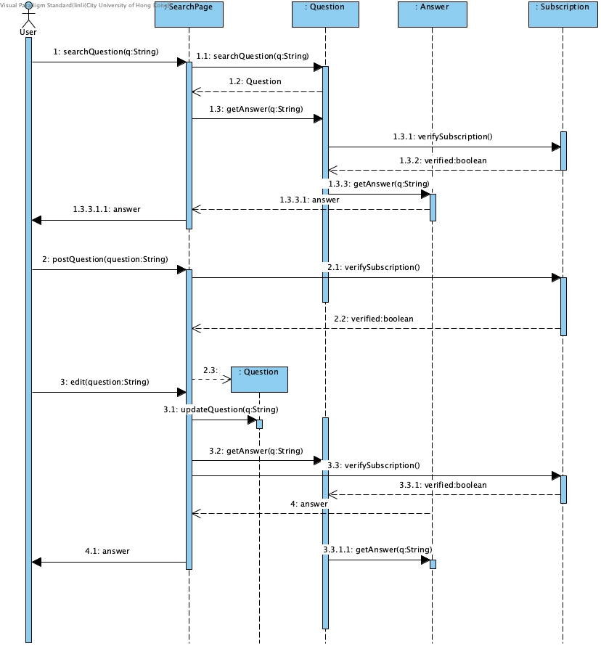
Question
module

Slide 34
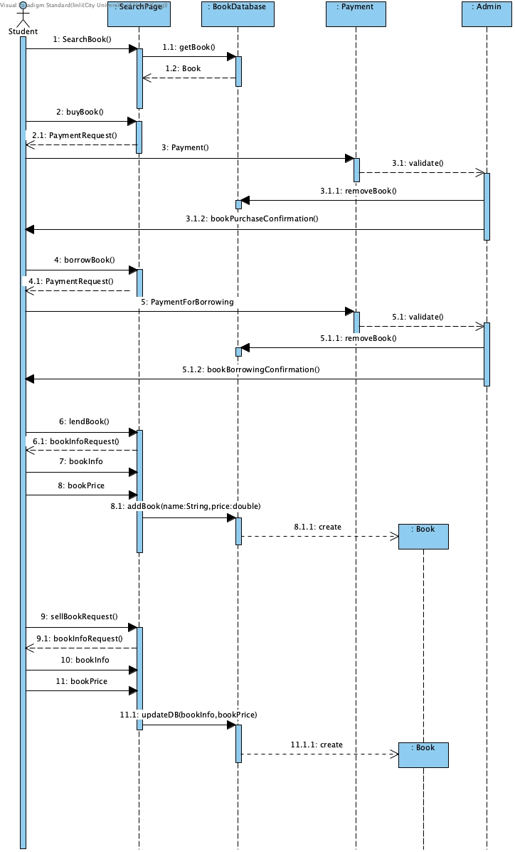
Buy/sell borrow/lend
module

Slide 35
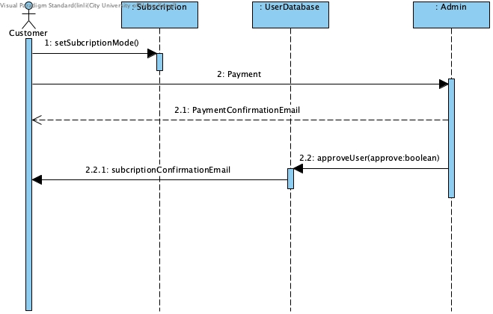
Subscription
module

Slide 36
Prototype
Pocket Library™ in action!

Slide 37
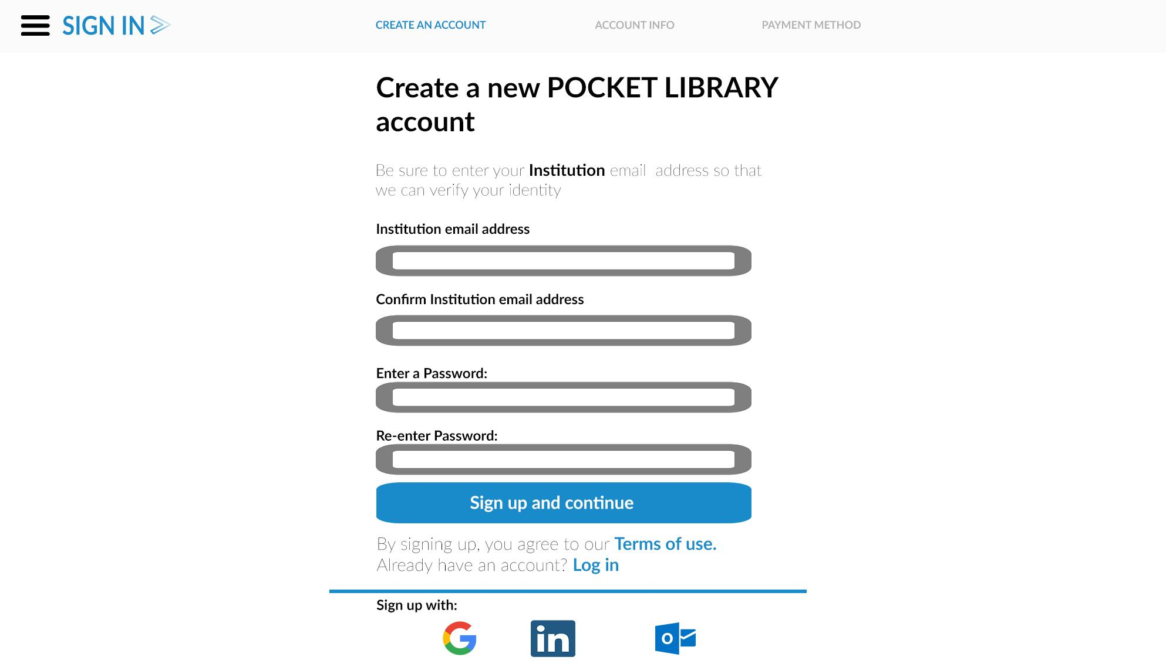
Prototype
Pocket Library™ in action!

Slide 38
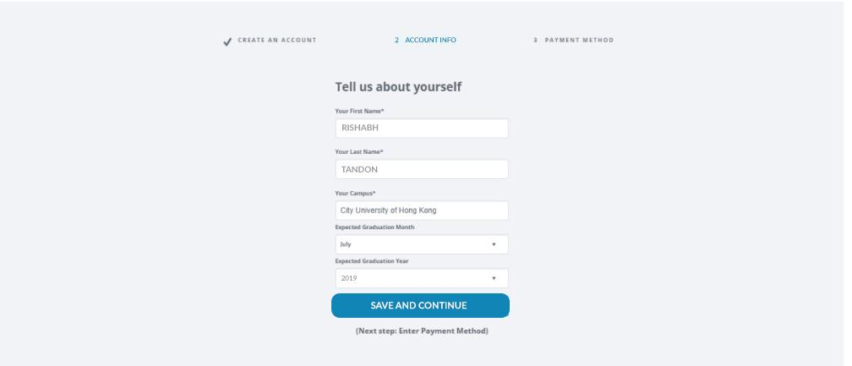

Slide 39
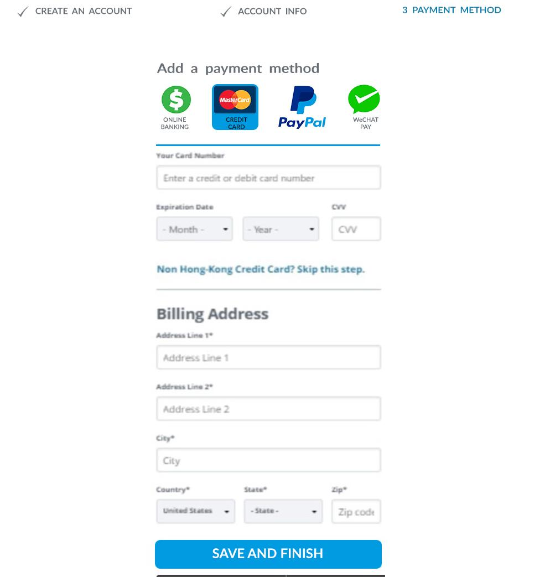

Slide 40
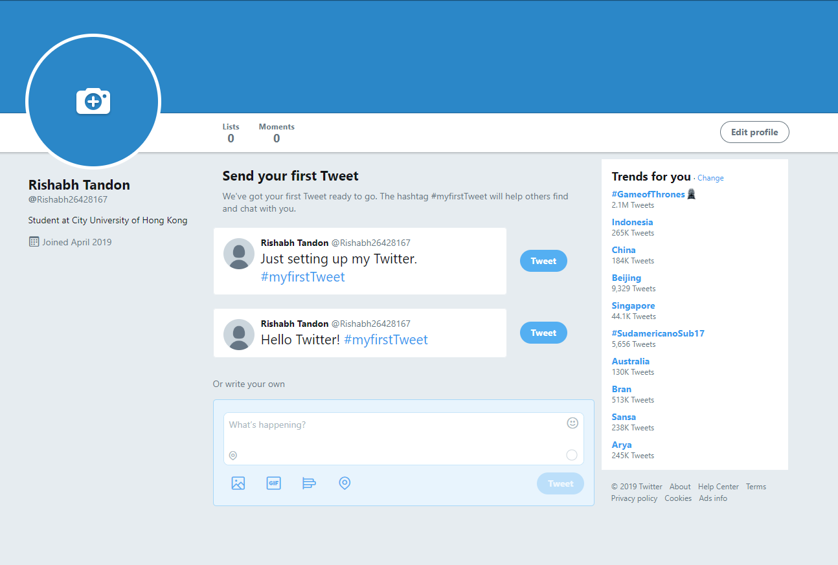
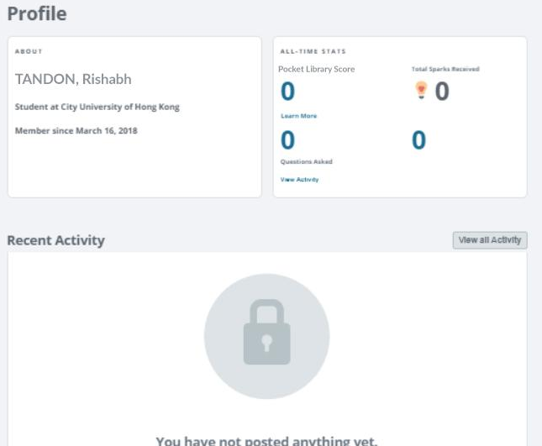
Prototype
Pocket Library™ in action!

Slide 41
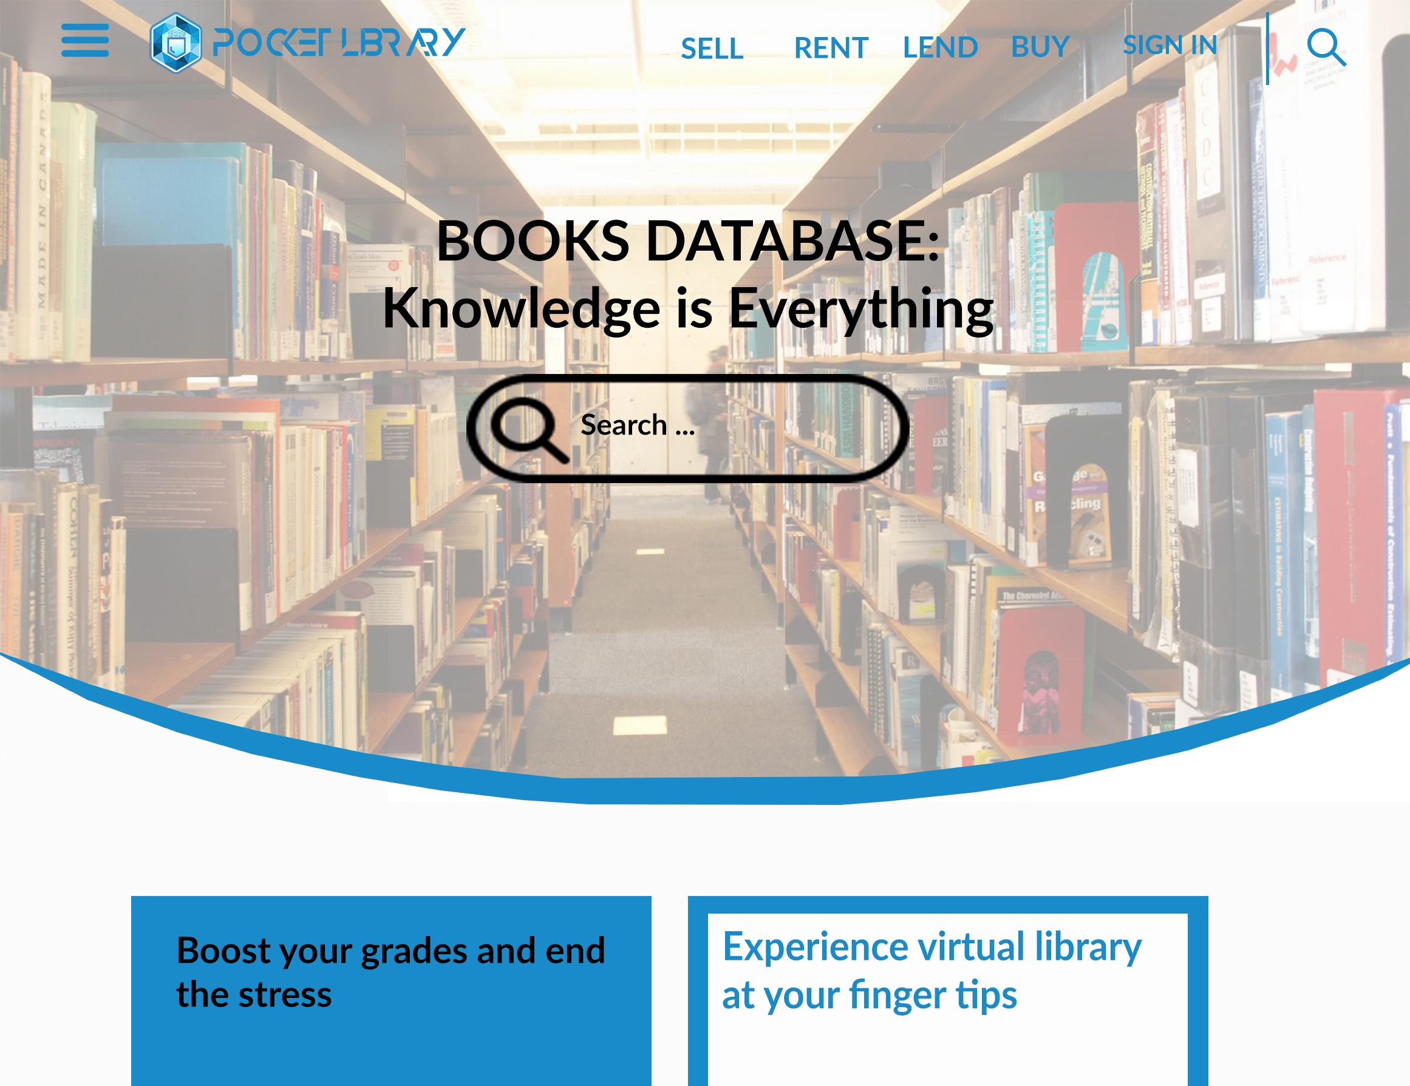
Prototype
Pocket Library™ in action!

Slide 42
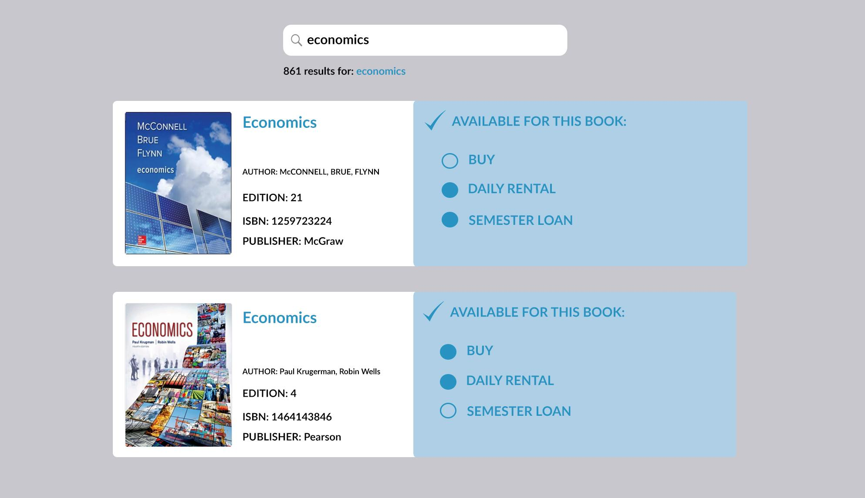
Prototype
Pocket Library™ in action!

Slide 43
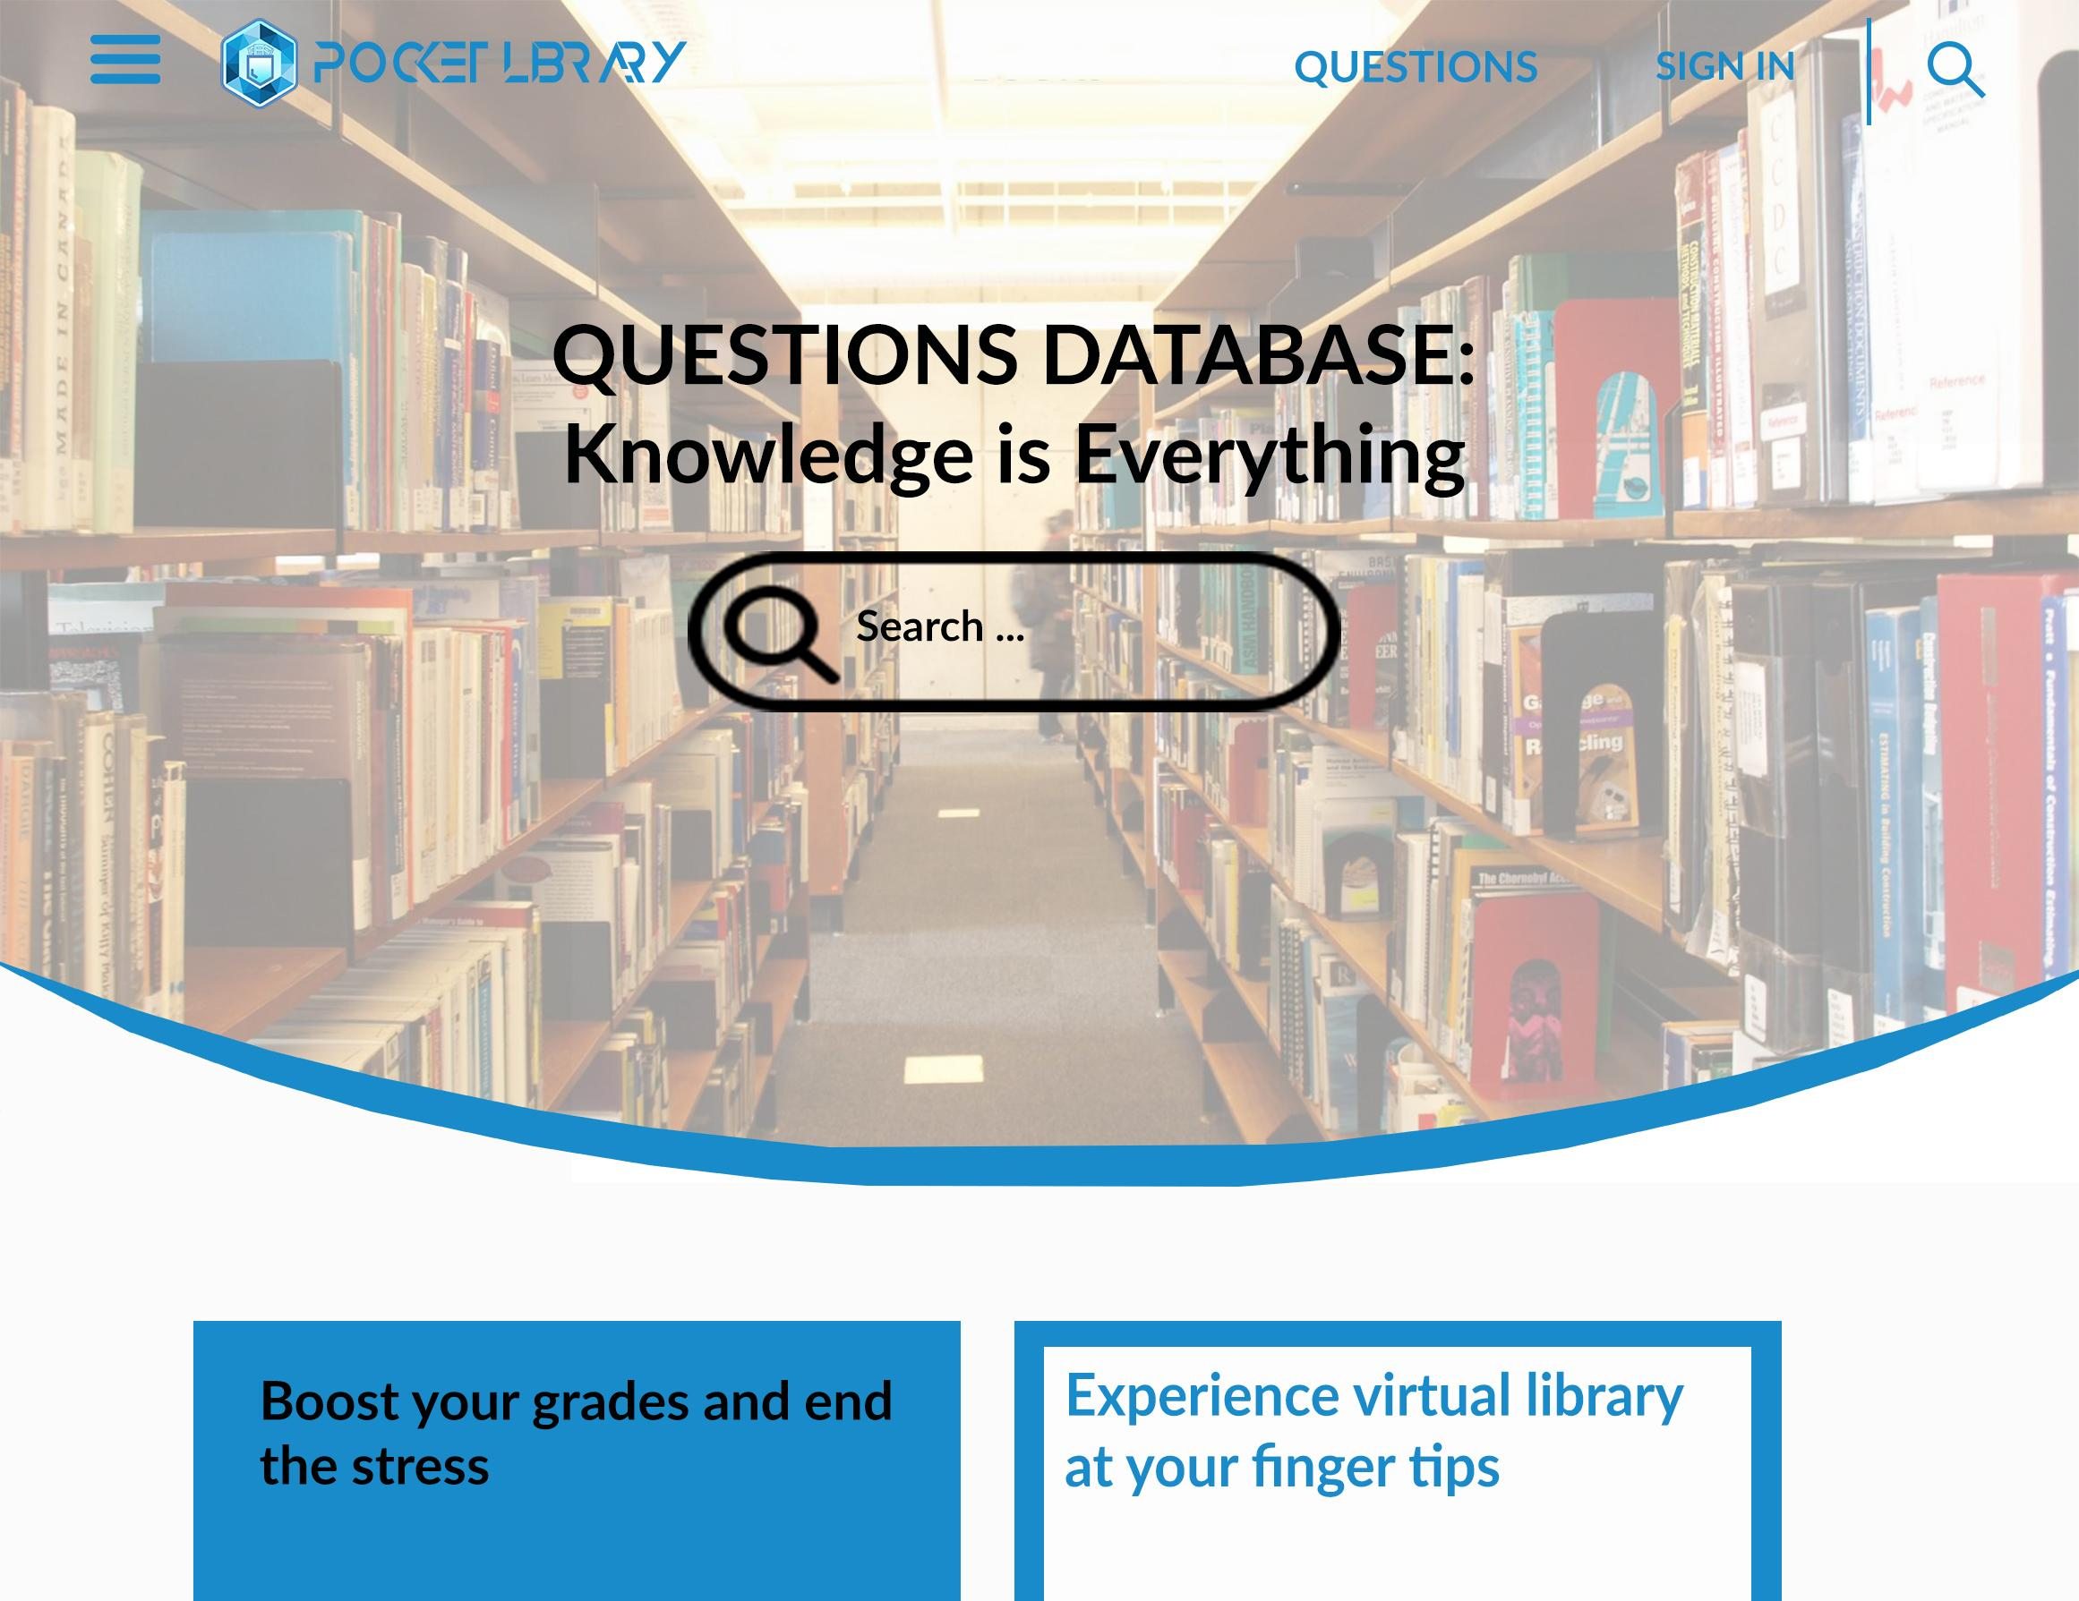
Prototype
Pocket Library™ in action!

Slide 44
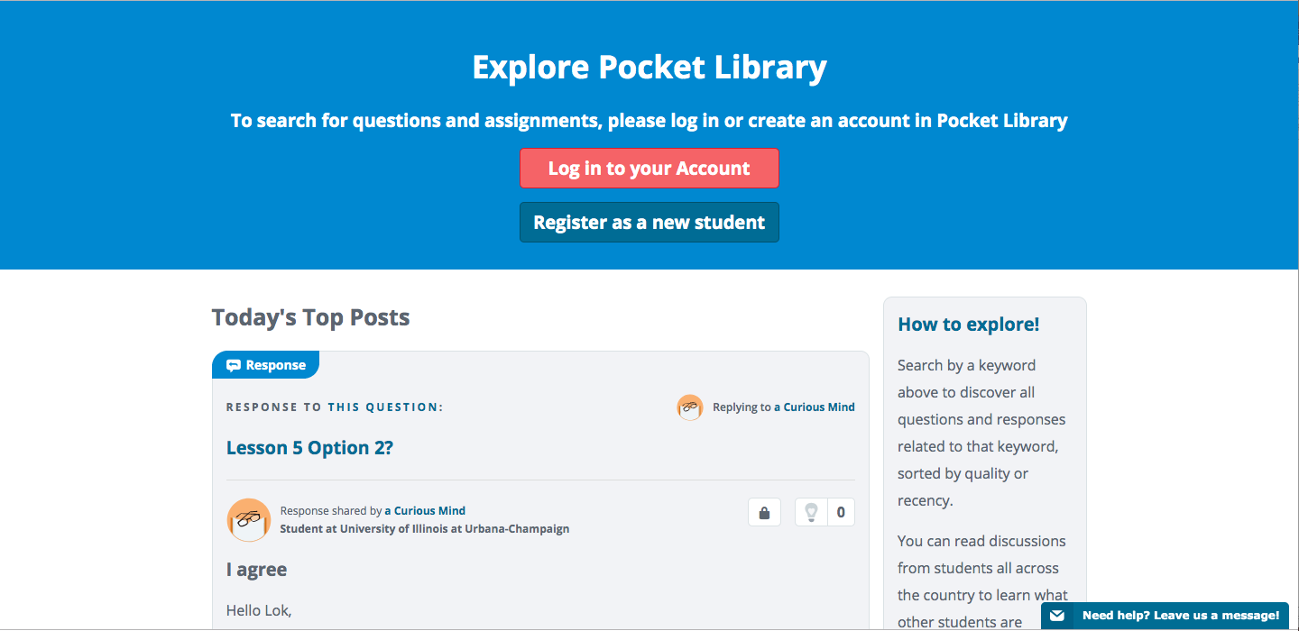
Prototype
Pocket Library™ in action!

Slide 45
Conclusion
Maintenance of Pocket Library™

Slide 46
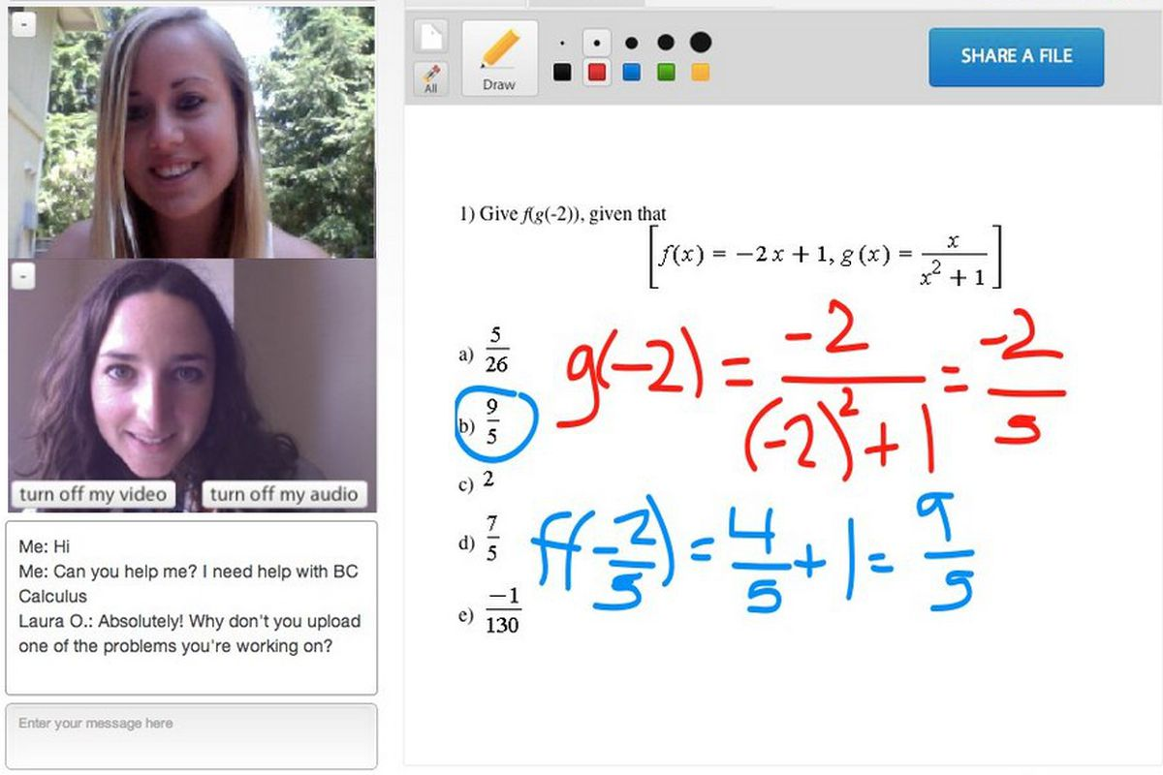

Overall Reflection
Applied requirement analysis and implemented the Prototype Process Model to our project
Analyzed various design principles and patterns and applied those (LSP, State Pattern, Command pattern) best suited for the project.
Learnt how to effectively adapt and modify classes based on changing requirements.
Our future work for the project involves designing an Android and iOS application, the inclusion of online tutor classes and the adaption of other payment methods to our platform.
Notes:
In total, we have learnt how to undertake a real software development project in a team.
First, we need to identify the user requirements. And then use design principles and design patterns to make our program clear and reusable. For example, state pattern can help to change the subscription status easily and Command pattern can help the administrator to redo/undo many functionalities.
We also have much work to do in the future. For example, because there exists many similar softwares in the market, we need to find our own competitiveness like updating software functions regularly, promotion and maintenance. Besides this, as the data about user account and questions/books information increases rapidly, we also need to consider design and using appropriate database to analyze and store these huge data.

Slide 47
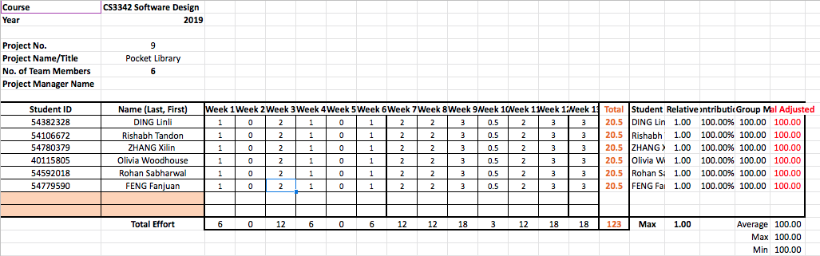
Teamwork

Slide 48
Thank You
any questions?

